Slide 1
Programming using Recursion
For first years

Slide 2
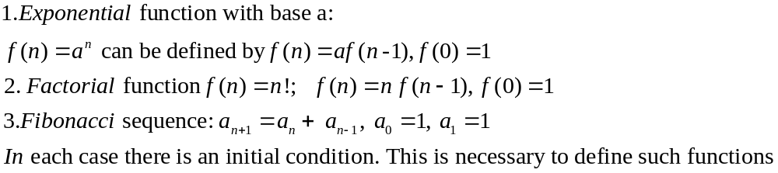
Recursion
Recursive functions: Functions that are defined in terms of themselves are called recursive functions, or recursively defined functions. This is not as strange as it sounds - a number of well-known functions can be defined in recursive form, and we are all familiar with so-called recursion relations (or difference equations), in which each term in a sequence is defined in terms of previous terms. Some examples:

Slide 3
Recursion- The pros and cons
expressive & powerful
difficult to grasp
can lead to elegant formulation of algorithms

Slide 4
MATLAB programming language, and most other high-level languages, allow functions to be recursively defined, i.e. to use their function values in their own definitions, as long as there is sufficient information for the function values to eventually be resolved. As an example, consider the Fibonacci sequence: We denote the nth term by F(n) and write a function for F in recursive form
function y=F(n)
if n==0|n==1
y=1;
else
y=F(n-1)+F(n-2);
end
end

Slide 5
What is wrong with Recursive functions?.
If we then ask for F(10), MATLAB executes the function F and discovers it needs to know F(9) and F(8) - then it tries to evaluate F(9) and F(8) and discovers it needs to know F(7) - it follows this chain of function evaluations until it finds F(2)=F(1)+F(0)=2 and then it works its way back up all the way to F(10). The number of unresolved function calls that MATLAB will allow at any one time is large (equal to 500, but may be changed by the user) but each such function call uses memory and you can run out of memory (not to mention have a very slow running program) if there are too many. Try calculating F(800) with the program in the previous slide and see what happens

Slide 6
More customary (and more efficient) way to calculate F(n) would be:
function y=F(n)
if n==0|n==1 y=1;
else
a=1;b=1;
for k=2:n
y=b+a; % ‘a and b are last two values in order
a=b;
y=b;
end
end
end

Slide 7
Polynomial evaluation with Recursive functions?.
In computer programming, recursive calculations are the most natural form in which to express functions. When we evaluate polynomials by nested multiplication we calculate p(x)= a₀ + a₁x +...+a_{n}x^{n} with the recursion p_{k} = a_{k} + x . p_{k+1} ,
p_{n} = a_{n} and p₀ is the value of the polynomial .
Of course when we implement this, we just write p = a_{k} + xp because we have no need to retain the intermediate terms of the sequence.

Slide 8
Polynomial evaluation-1
function y=mypolyval(c,x)
%c is the array of coefficients, from lowest to highest power
% x can be array of values at which evaluation is to be carried out
% let us assume x is scalar
n=length(c);
y=c(n);
for i=(n-1):-1:1
y=c(i)+x*y;
end
disp(y)
end

Slide 9
Polynomial evaluation-2
function y=mypolyval(c,x)
%c is the array of coefficients, from lowest to highest power
% x can be array of values at which evaluation is to be carried out
% let us assume x is a vector of values
n=length(c);
y=c(n)*ones(size(x)); % y is an array of values
for i=(n-1):-1:1
y=c(i)+x.*y; % y is an array of values
end
disp(y)
end

Slide 10
Recursive
Polynomial evaluation-3
function y=polyvalr(p,x)
%recursive formulation of polynomial evaluation
%p is the array of coefficients
if length(p)==0
y=zeros(size(x));
else y=p(1) + x.*polyvalr(p(2:end),x)
end
end

Slide 11
maximum value in an array
The maximum value in an array is the maximum of the first element and the maximum of all elements after the first. This gives rise to
x=randi([1 5], 1,8)
y=maxr(x)
function y=maxr(x)
%find maximum value of array x
if length(x)==1
y=x;
else
if x(1)>maxr(x(2:end))
y=x(1);
else
y=maxr(x(2:end));
end
end
end

Slide 12
Factorial
x=fact(10)
function res = fact(n)
if n == 0 res = 1;
else
res = n * fact(n-1);
end
end

Slide 13
String Reversal reversing string, #1:
function s = reverse1(s)
if length(s) >= 1
s = [ s(end) reverse1(s(1:end-1)) ]; % Appending array
end
end

Slide 14
String Reversal reversing string, #2:
y=reverse2('abcd')
function s = reverse2(s)
if length(s) >= 1
s = [reverse2(s(2:end)) s(1) ]; % Appending array
end
end

Slide 15
Palindrome
%making a palindrome:
y=reflect('abcd')
function s = reflect(s)
if length(s) >= 1
s = [ s(1) reflect(s(2:end)) s(1) ]; % Appending array
end
end

Slide 16
Recursion-Advanced
What happens behind the scene

Slide 17
Consider multiplication of two 4 digit numbers
2133 and 2312
Divide the problems into multiplication of
Three 2 digit numbers.
21x23, 33x12, (21+33)(23+12)
We have 3 subproblems
Divide each subproblem into another 3 one digit multiplication problem. Each of these problems is called our ‘base problem’ which cannot be further divided

Slide 18
Code
Representation of an Algorithm
MULT(X,Y):
If |X| = |Y| = 1 then RETURN XY
Break X into a;b and Y into c;d
e = MULT(a,c) and f =MULT(b,d)
RETURN
e 10^{n} + (MULT(a+b, c+d) – e - f) 10^{n/2} + f

Slide 19
Tree of Frames
MULT(X,Y):
If |X| = |Y| = 1 then RETURN XY
Break X into a;b and Y into c;d
e = MULT(a,c) and f =MULT(b,d)
RETURN
e 10^{n} + (MULT(a+b, c+d) – e - f) 10^{n/2} + f
a=21, b=33
c=23 , d=12
X = 2133
Y = 2312
e=ac = 483
f=bd = 396
(a+b)(c+d) = 1890
XY = 4931496
You get help of three friends to
do three multiplications
Here n=4
ac
bd
(a+b)(c+d)
X = 21
Y = 23
e=ac = 4
f=bd = 3
(a+b)(c+d) = 15
XY = 483
X = 33
Y = 12
e=ac = 3
f=bd = 6
(a+b)(c+d) = 18
XY = 396
X = 54
Y = 35
e=ac = 15
f=bd = 20
(a+b)(c+d) = 72
XY = 1890
You get help of three friends
To do three multiplications
Here n=2
ac
bd
(a+b)(c+d)
ac
bd
(a+b)(c+d)
ac
(a+b)(c+d)
bd
X = 2
Y = 2
XY=4
X = 1
Y = 3
XY=3
X = 3
Y = 5
XY=15
X = 3
Y = 1
XY=3
X = 3
Y = 2
XY=6
X = 6
Y = 3
XY=18
X = 5
Y = 3
XY=15
X = 4
Y = 5
XY=20
X = 9
Y = 8
XY=72

Slide 20
Friends
MULT(X,Y):
If |X| = |Y| = 1 then RETURN XY
Break X into a;b and Y into c;d
e = MULT(a,c) and f =MULT(b,d)
RETURN
e 10^{n} + (MULT(a+b, c+d) – e - f) 10^{n/2} + f
One Friend for each stack frame.
Each worries only about his job.
X = 2133
Y = 2312
ac = 483
bd = 396
(a+b)(c+d) = 1890
XY = 4931496
X = 21
Y = 23
ac = 4
bd = 3
(a+b)(c+d) = 15
XY = 483
X = 33
Y = 12
ac = 3
bd = 6
(a+b)(c+d) = 18
XY = 396
X = 54
Y = 35
ac = 15
bd = 20
(a+b)(c+d) = 72
XY = 1890
X = 2
Y = 2
XY=4
X = 1
Y = 3
XY=3
X = 3
Y = 5
XY=15
X = 3
Y = 1
XY=3
X = 3
Y = 2
XY=6
X = 6
Y = 3
XY=18
X = 5
Y = 3
XY=15
X = 4
Y = 5
XY=20
X = 9
Y = 8
XY=72

Slide 21
Friends
MULT(X,Y):
If |X| = |Y| = 1 then RETURN XY
Break X into a;b and Y into c;d
e = MULT(a,c) and f =MULT(b,d)
RETURN
e 10^{n} + (MULT(a+b, c+d) – e - f) 10^{n/2} + f
Worry about one step at a time.
Imagine that you are one specific friend.
X = 2133
Y = 2312
ac = 483
bd = 396
(a+b)(c+d) = 1890
XY = 4931496
X = 21
Y = 23
ac = 4
bd = 3
(a+b)(c+d) = 15
XY = 483
X = 33
Y = 12
ac = 3
bd = 6
(a+b)(c+d) = 18
XY = 396
X = 54
Y = 35
ac = 15
bd = 20
(a+b)(c+d) = 72
XY = 1890
X = 2
Y = 2
XY=4
X = 1
Y = 3
XY=3
X = 3
Y = 5
XY=15
X = 3
Y = 1
XY=3
X = 3
Y = 2
XY=6
X = 6
Y = 3
XY=18
X = 5
Y = 3
XY=15
X = 4
Y = 5
XY=20
X = 9
Y = 8
XY=72

Slide 22
Friends
MULT(X,Y):
If |X| = |Y| = 1 then RETURN XY
Break X into a;b and Y into c;d
e = MULT(a,c) and f =MULT(b,d)
RETURN
e 10^{n} + (MULT(a+b, c+d) – e - f) 10^{n/2} + f
Consider your input instance
X = 33
Y = 12
ac =
bd =
(a+b)(c+d) =
XY =

Slide 23
Friends
MULT(X,Y):
If |X| = |Y| = 1 then RETURN XY
Break X into a;b and Y into c;d
e = MULT(a,c) and f =MULT(b,d)
RETURN
e 10^{n} + (MULT(a+b, c+d) – e - f) 10^{n/2} + f
Consider your input instance
Allocate work
  Construct one or more subinstances
X = 33
Y = 12
ac = ?
bd = ?
(a+b)(c+d) =
XY =
X = 3
Y = 1
XY=?
X = 3
Y = 2
XY=?
X = 6
Y = 3
XY=?

Slide 24
Friends
MULT(X,Y):
If |X| = |Y| = 1 then RETURN XY
Break X into a;b and Y into c;d
e = MULT(a,c) and f =MULT(b,d)
RETURN
e 10^{n} + (MULT(a+b, c+d) – e - f) 10^{n/2} + f
Consider your input instance
Allocate work
  Construct one or more subinstances
  Assume by magic your friends give you the answer for these.
X = 33
Y = 12
ac = 3
bd = 6
(a+b)(c+d) = 18
XY =
X = 3
Y = 1
XY=3
X = 3
Y = 2
XY=6
X = 6
Y = 3
XY=18

Slide 25
Friends
MULT(X,Y):
If |X| = |Y| = 1 then RETURN XY
Break X into a;b and Y into c;d
e = MULT(a,c) and f =MULT(b,d)
RETURN
e 10^{n} + (MULT(a+b, c+d) – e - f) 10^{n/2} + f
Consider your input instance
Allocate work
  Construct one or more subinstances
  Assume by magic your friends give you the answer for these.
Use this help to solve your own instance.
X = 33
Y = 12
ac = 3
bd = 6
(a+b)(c+d) = 18
XY = 396
X = 3
Y = 1
XY=3
X = 3
Y = 2
XY=6
X = 6
Y = 3
XY=18

Slide 26
Friends
MULT(X,Y):
If |X| = |Y| = 1 then RETURN XY
Break X into a;b and Y into c;d
e = MULT(a,c) and f =MULT(b,d)
RETURN
e 10^{n} + (MULT(a+b, c+d) – e - f) 10^{n/2} + f
Consider your input instance
Allocate work
  Construct one or more subinstances
  Assume by magic your friends give you the answer for these.
Use this help to solve your own instance.
Do not worry about anything else.
  Who your boss is.
  How your friends solve their instance.
X = 33
Y = 12
ac = 3
bd = 6
(a+b)(c+d) = 18
XY = 396
X = 3
Y = 1
XY=3
X = 3
Y = 2
XY=6
X = 6
Y = 3
XY=18

Slide 27
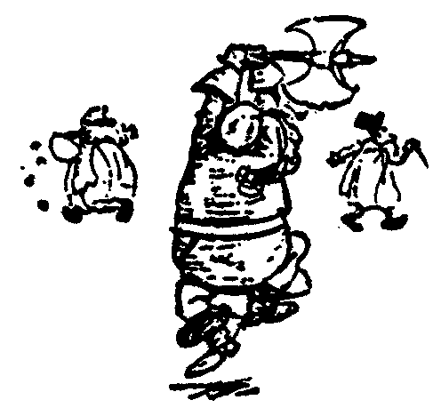
Friends
MULT(X,Y):
If |X| = |Y| = 1 then RETURN XY
Break X into a;b and Y into c;d
e = MULT(a,c) and f =MULT(b,d)
RETURN
e 10^{n} + (MULT(a+b, c+d) – e - f) 10^{n/2} + f
This technique is often
referred to as
Divide and Conquer
X = 33
Y = 12
ac = 3
bd = 6
(a+b)(c+d) = 18
XY = 396
X = 3
Y = 1
XY=3
X = 3
Y = 2
XY=6
X = 6
Y = 3
XY=18

Slide 28
Friends
MULT(X,Y):
If |X| = |Y| = 1 then RETURN XY
Break X into a;b and Y into c;d
e = MULT(a,c) and f =MULT(b,d)
RETURN
e 10^{n} + (MULT(a+b, c+d) – e - f) 10^{n/2} + f
Consider generic instances.
MULT(X,Y):
Break X into a;b and Y into c;d
e = MULT(a,c) and f =MULT(b,d)
RETURN
e 10^{n} + (MULT(a+b, c+d) – e - f) 10^{n/2} + f
MULT(X,Y):
If |X| = |Y| = 1 then RETURN XY
Remember!
Do not worry about
  Who your boss is.
  How your friends solve their instance.
ac
bd
(a+b)(c+d)

Slide 29
Friends
MULT(X,Y):
If |X| = |Y| = 1 then RETURN XY
Break X into a;b and Y into c;d
e = MULT(a,c) and f =MULT(b,d)
RETURN
e 10^{n} + (MULT(a+b, c+d) – e - f) 10^{n/2} + f
This solves the problem for every possible instance.
X = 2133
Y = 2312
ac = 483
bd = 396
(a+b)(c+d) = 1890
XY = 4931496
X = 21
Y = 23
ac = 4
bd = 3
(a+b)(c+d) = 15
XY = 483
X = 33
Y = 12
ac = 3
bd = 6
(a+b)(c+d) = 18
XY = 396
X = 54
Y = 35
ac = 15
bd = 20
(a+b)(c+d) = 72
XY = 1890
X = 2
Y = 2
XY=4
X = 1
Y = 3
XY=3
X = 3
Y = 5
XY=15
X = 3
Y = 1
XY=3
X = 3
Y = 2
XY=6
X = 6
Y = 3
XY=18
X = 5
Y = 3
XY=15
X = 4
Y = 5
XY=20
X = 9
Y = 8
XY=72

Slide 30
Friends
Recursive Algorithm:
  Assume you have an algorithm that works.
  Use it to write an algorithm that works.

Slide 31

Friends
Recursive Algorithm:
  Assume you have an algorithm that works.
  Use it to write an algorithm that works.
If I could get in,
I could get the key.
Then I could unlock the door
so that I can get in.
Circular Argument!

Slide 32
Friends & Strong Induction
Recursive Algorithm:
  Assume you have an algorithm that works.
  Use it to write an algorithm that works.
To get into my house
I must get the key from a smaller house

Slide 33
Friends & Strong Induction
MULT(X,Y):
If |X| = |Y| = 1 then RETURN XY
Break X into a;b and Y into c;d
e = MULT(a,c) and f =MULT(b,d)
RETURN
e 10^{n} + (MULT(a+b, c+d) – e - f) 10^{n/2} + f
Allocate work
  Construct one or more subinstances
X = 33
Y = 12
ac = ?
bd = ?
(a+b)(c+d) =
XY =
  Each subinstance must be
  a smaller instance
  to the same problem.
X = 3
Y = 1
XY=?
X = 3
Y = 2
XY=?
X = 6
Y = 3
XY=?

Slide 34
Friends & Strong Induction
Recursive Algorithm:
  Assume you have an algorithm that works.
  Use it to write an algorithm that works.
Use brute force
to get into
the smallest house.

Slide 35
Friends
MULT(X,Y):
If |X| = |Y| = 1 then RETURN XY
Break X into a;b and Y into c;d
e = MULT(a,c) and f =MULT(b,d)
RETURN
e 10^{n} + (MULT(a+b, c+d) – e - f) 10^{n/2} + f
MULT(X,Y):
If |X| = |Y| = 1 then RETURN XY
Use brute force
to solve the base case instances.

Slide 36
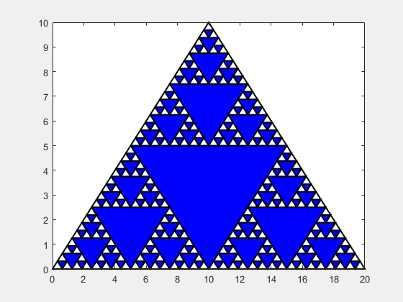
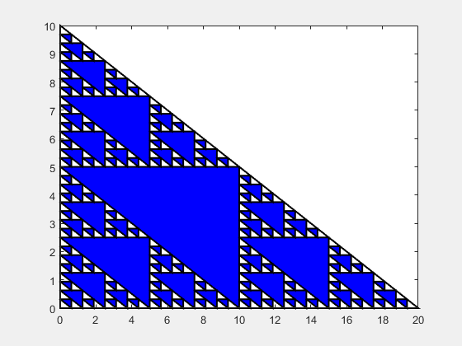
Recursive subdivision
Figure out how recursion works

Slide 37
Join the midpoints of each side and remove
the resulting triangle
Do the same for the resulting triangles

Slide 38
x1=[0 0 20]’; y1=[0 10 0]’; L1=5;
%x1=[0 10 20]’; y1=[0 10 0]’; L1=5;
Sierpinsky(x1,y1,L1)
function Sierpinsky(x,y,L)
% x and y are 3-vector s.
% L represent levels
if L==0
fill(x,y,'w','linewidth',1.5)
hold on
else
% A subdivision is called for...
% Determine the side midpoints (a(1),b(1)), (a(2),b(2)), and (a(3),b(3))
a = [(x(1)+x(2))/2 (x(2)+x(3))/2 (x(3)+x(1))/2];
b = [(y(1)+y(2))/2 (y(2)+y(3))/2 (y(3)+y(1))/2];
% Color the interior triangle blue...
fill(a,b,'b','linewidth',1.5)
hold on
pause(0.5)
% Apply the process to the three "outer" triangles...
Sierpinsky([x(1) a(1) a(3)],[y(1) b(1) b(3)],L-1)
Sierpinsky([a(1) x(2) a(2)],[b(1) y(2) b(2)],L-1)
Sierpinsky([a(3) a(2) x(3)],[b(3) b(2) y(3)],L-1)
end
end

Slide 39
Tower of Hanoi

Slide 40
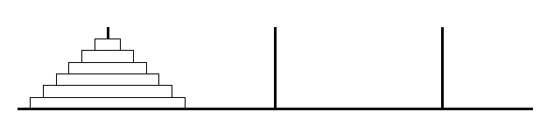
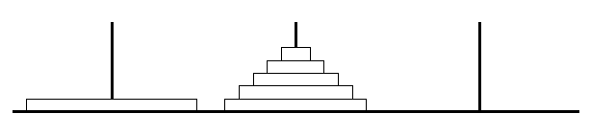
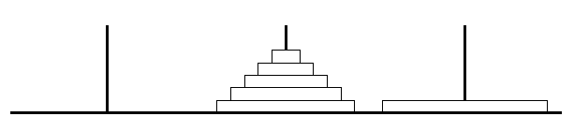
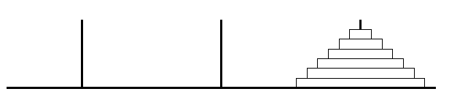
Towers of Hanoi
Start
Intermediate
End

Slide 41
move disk 1 from peg A to peg C
move disk 2 from peg A to peg B
move disk 1 from peg C to peg B
move disk 3 from peg A to peg C
move disk 1 from peg B to peg A
move disk 2 from peg B to peg C
move disk 1 from peg A to peg C
A
B
C
A
B
C
1
A
B
C
A
B
C
2
5
A
B
C
A
B
C
3
6
A
B
C
A
B
C
4
7

Slide 42
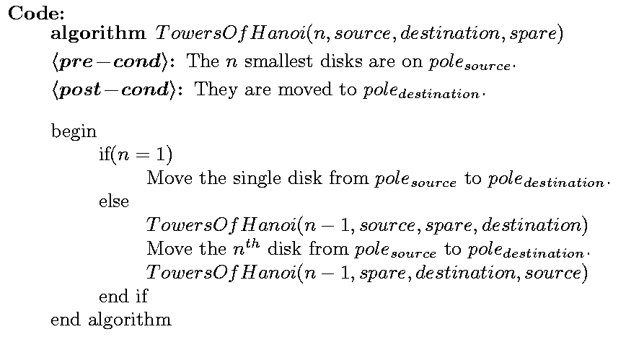
Towers of Hanoi
Time: T(1)=1, T(n) = 2T(n-1) + 1 =
Θ(2^{n})

Slide 43
Move1: move disk 1 from peg A to peg C
Move2: move disk 2 from peg A to peg B
Move3: move disk 1 from peg C to peg B
Move4: move disk 3 from peg A to peg C
Move5: move disk 1 from peg B to peg A
Move6: move disk 2 from peg B to peg C
Move7: move disk 1 from peg A to peg C
3,A, C,B
1
2
3
Get it done first
Move4
Refer code in next page
Move disk 3 from A to C
2,B, C,A
2,A, B,C
Move2
Move6
Move1
Move3
Move5
Move7

Slide 44
Move A to C with help of B
A
B
C
B
A
C
towers(3, ‘A’, ‘C’,’B’)
function[] = towers(n, frompeg, topeg, auxpeg);
if (n == 1)
fprintf('\t move disk 1 from peg %c to peg %c \n’, frompeg, topeg);
else
towers(n-1, frompeg, auxpeg, topeg);
fprintf('\t move disk %d from peg %c to peg %c \n', n,frompeg,topeg);
towers(n-1,auxpeg,topeg,frompeg);
end;

Slide 45
Q1 Modify the code . Function should return
Number of steps taken
towers(3, ‘A’, ‘C’,’B’)
function[] = towers(n, frompeg, topeg, auxpeg);
if (n == 1)
fprintf('\t move disk 1 from peg %c to peg %c \n’, frompeg, topeg);
else
towers(n-1, frompeg,auxpeg,topeg);
fprintf('\t move disk %d from peg %c to peg %c \n', n,frompeg,topeg);
towers(n-1,auxpeg,topeg,frompeg);
end;

Slide 46
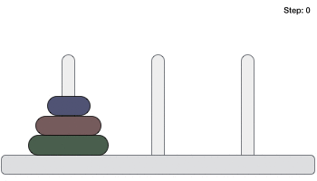
Q2 Animate the Tower of Hanoi either by using
MATLAB, MIT ‘Scratch’ or ‘SNAP’ or processing
Animation
Source: Disk A
Destination: Disk B

Slide 47
Projects using Recursion

Slide 48

Programming let you create the
unimaginable
Read the book

Slide 49
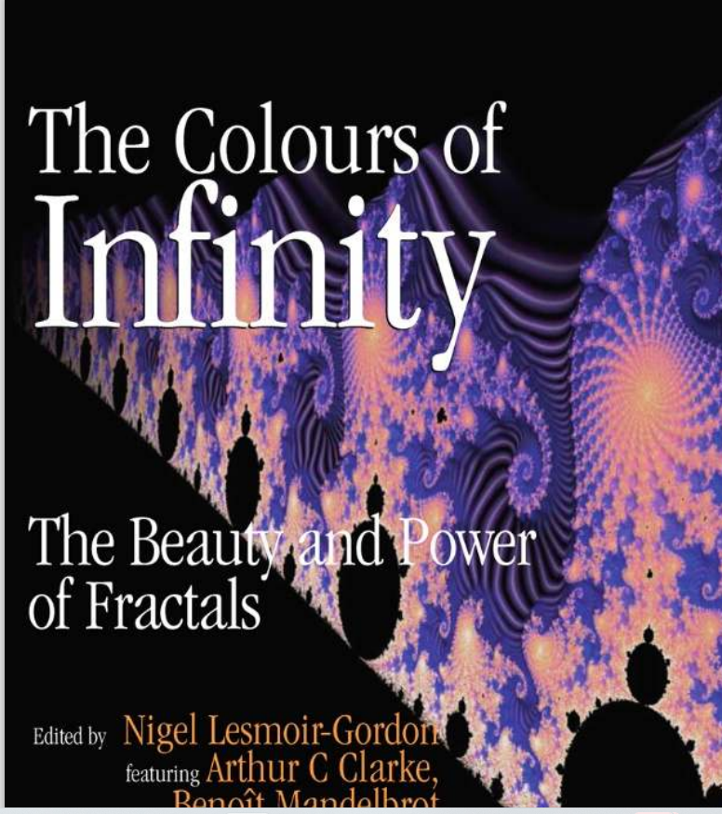
Read the book

Slide 50
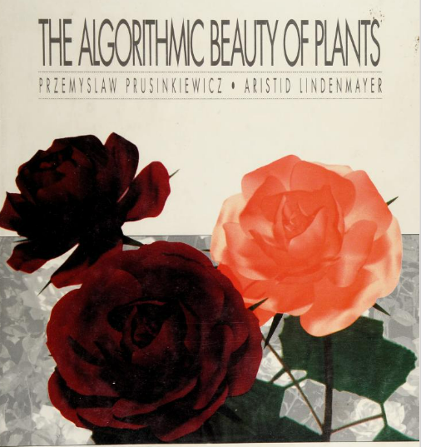
Read the book

Slide 51
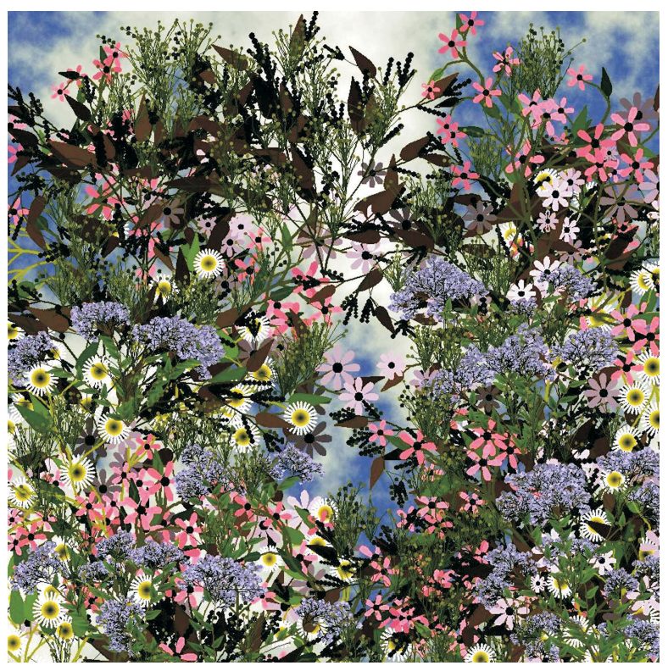
Some imaginary inflorescences

Slide 52
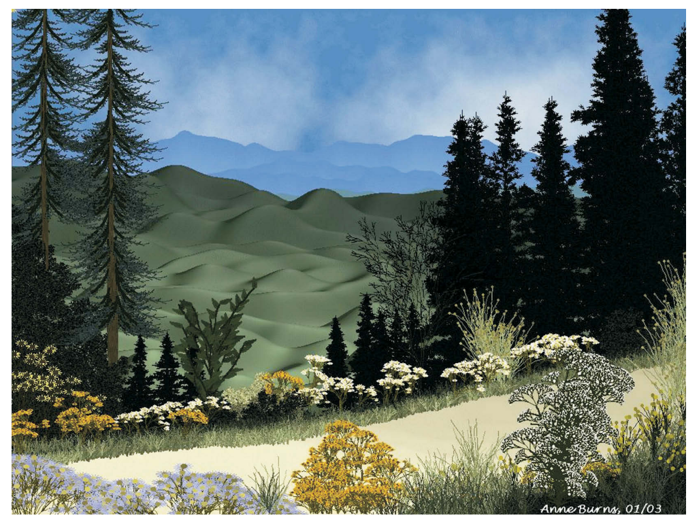

Slide 53
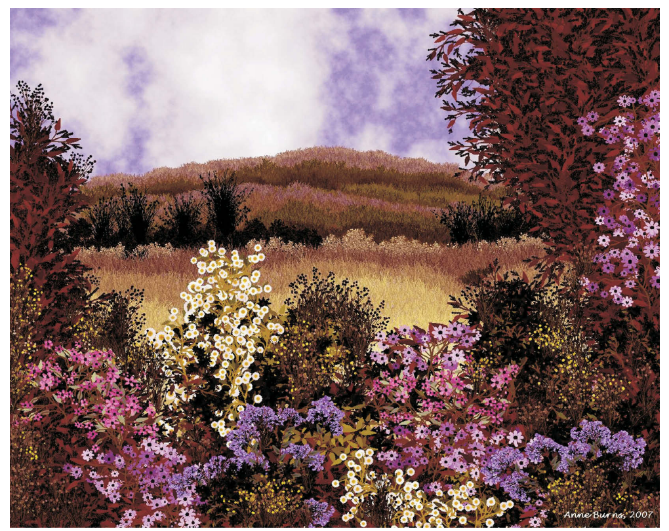

Slide 54
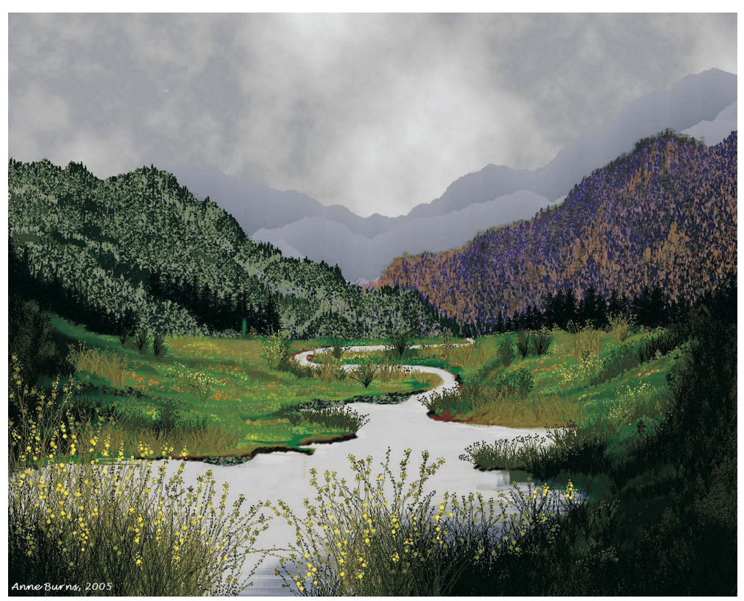

Slide 55

A decorative plant

Slide 56
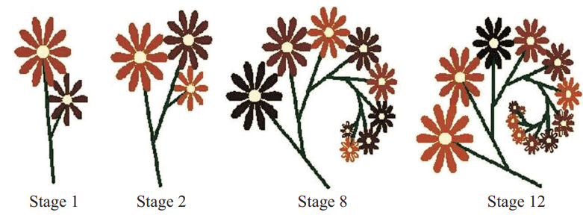

Slide 57
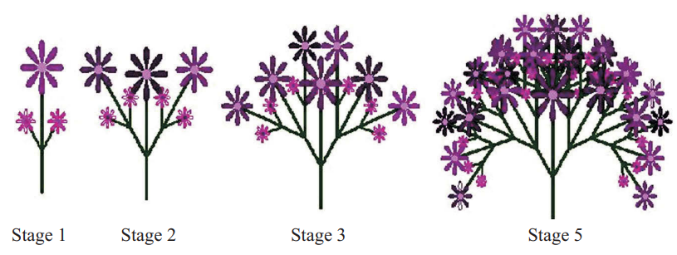

Slide 58
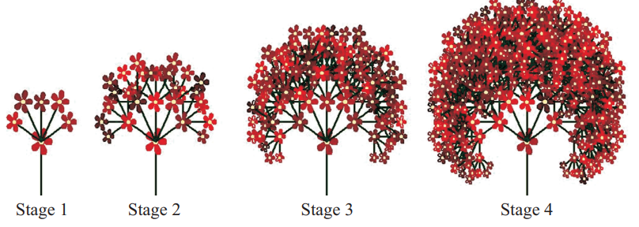

Slide 59
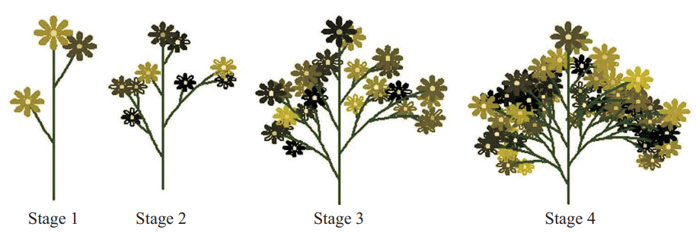

Slide 60
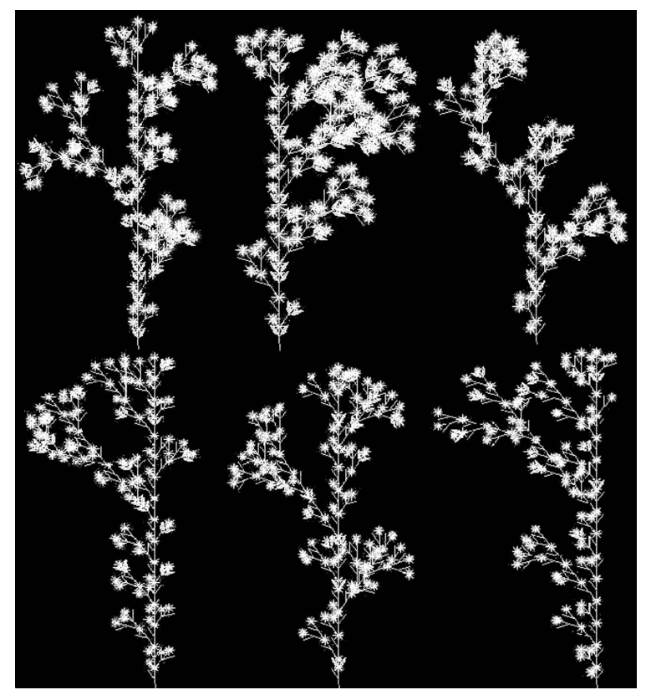

Slide 61
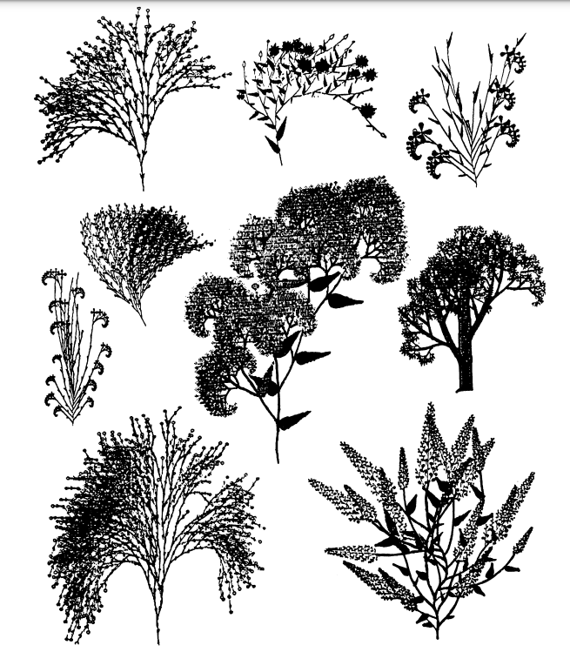


ILF*
(ILF)
I
[ILF]
I
Prescribing Plat Growth

Slide 62
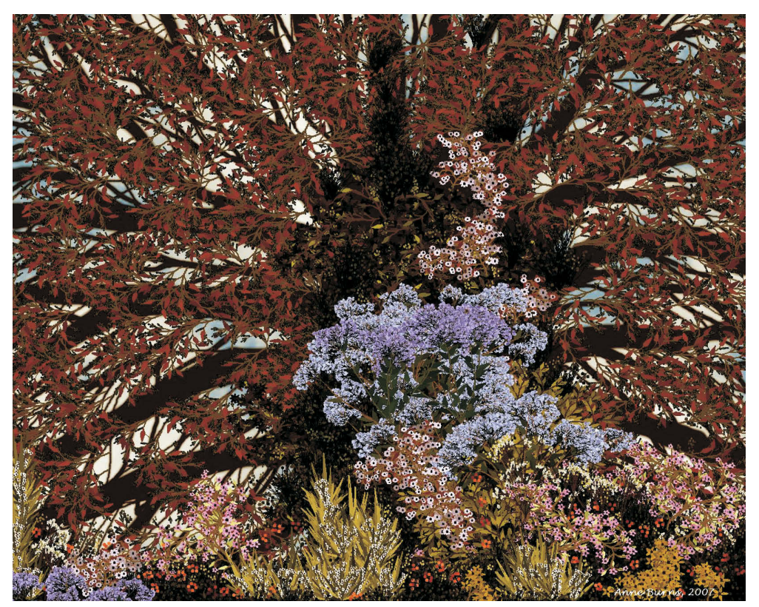

Slide 63
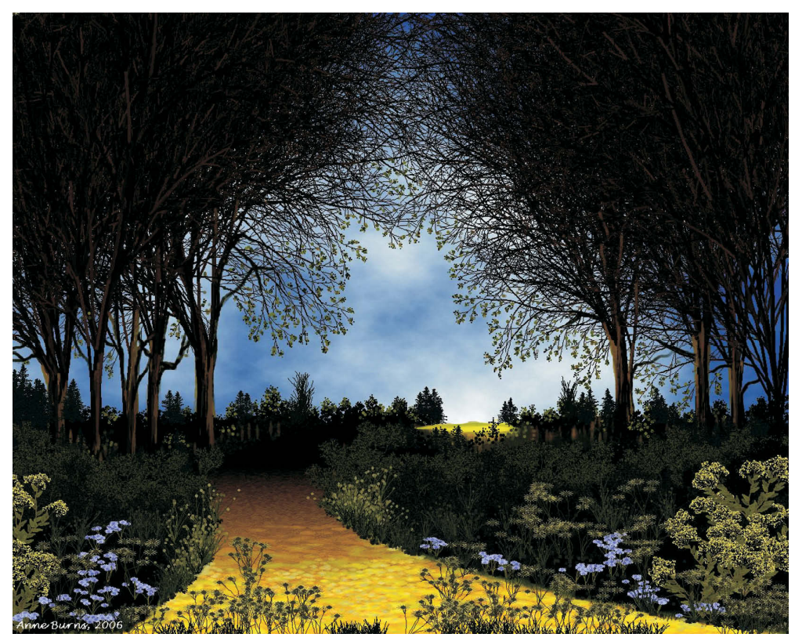

Slide 64
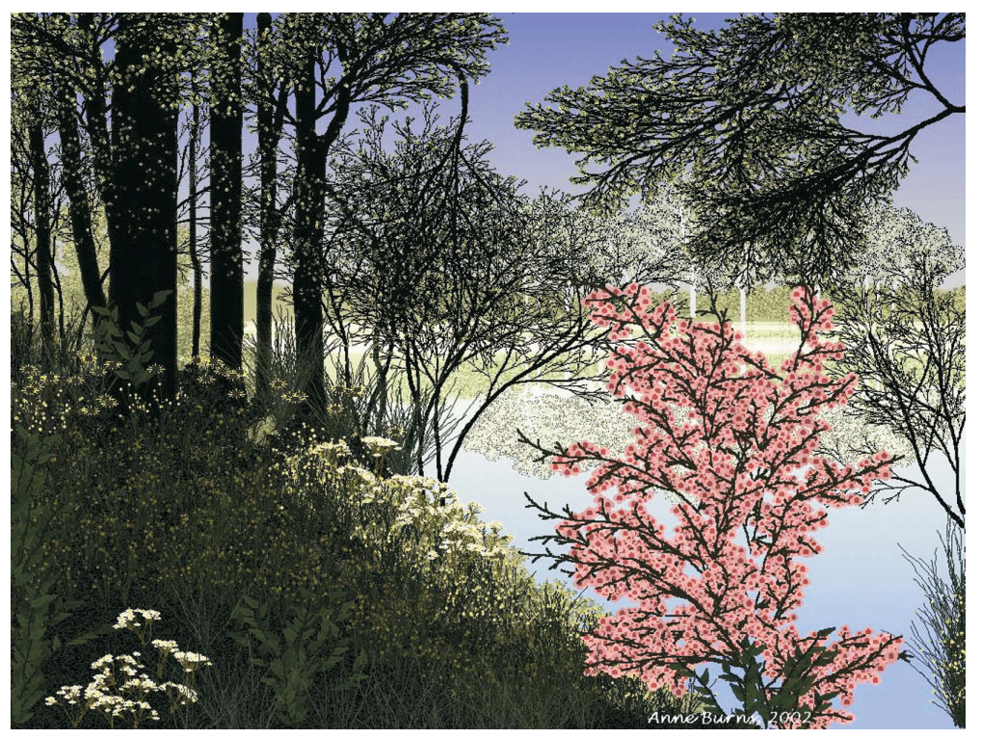

Slide 65
Extras

Slide 66
break statement
The break statement ends a loop, e.g.:
for i=1:10
if i==5 break end
disp(i)
end
outputs:
1
2
3
4

Slide 67
continue statement
the continue statement skips an iteration of a loop,e.g.:
for i=1:5
if i==3
continue
end
disp(i)
end
outputs:
1
2
4
5

Slide 68
return statement
test whether n is a prime (same as isprime):
function res = is_prime(n)
res = false;
for i=2:n-1
if mod(n, i) == 0 return end
end
res = true;
end
most languages have a combined return statement: return (value)
replacing both return and an output variable: res = (value); return

Slide 69
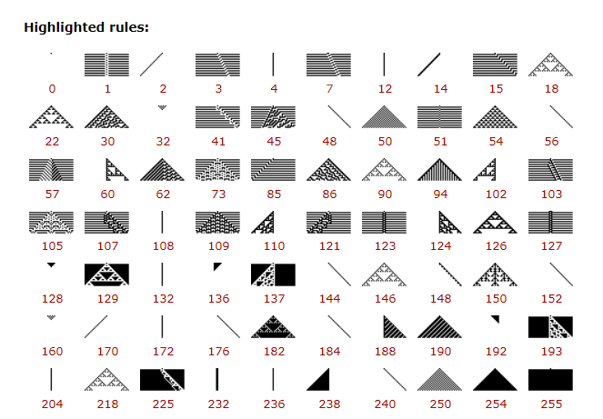
http://atlas.wolfram.com/01/01/
https://www.wolframscience.com/reference/basicimages.html
https://eng.libretexts.org/Bookshelves/Electrical_Engineering/Signal_Processing_and_Modeling/Fast_Fourier_Transforms_(Burrus)/02%3A_Multidimensional_Index_Mapping/2.05%3A_The_FFT_as_a_Recursive_Evaluation_of_the_DFT

Slide 70
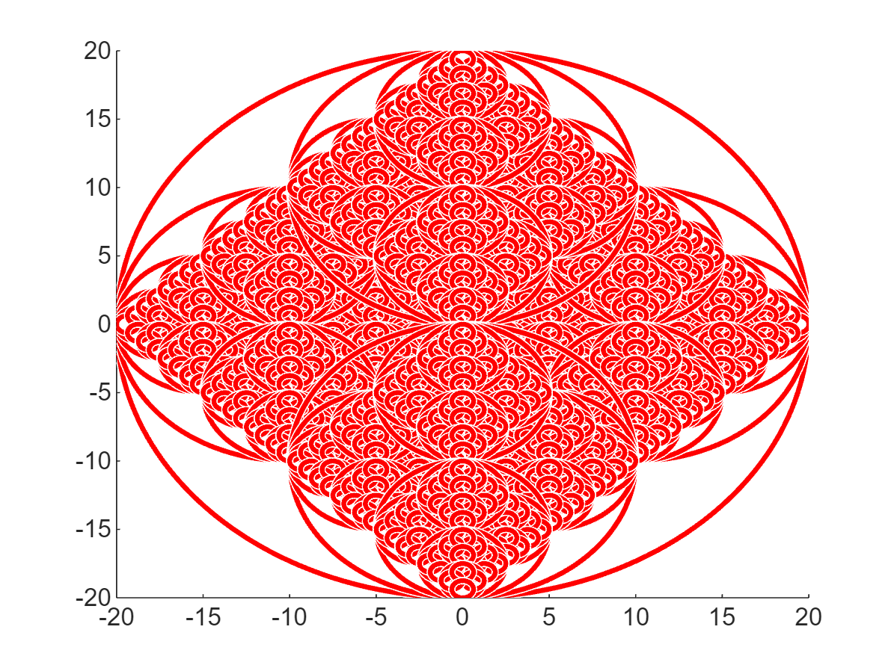

Slide 71

Recursion
drawCircles2(0,0,20)
axis off
function drawCircles2(x, y, radius)
viscircles([x, y], radius);
if (radius > 1)
drawCircles2(x + radius / 2, y, radius / 2);
drawCircles2(x - radius / 2, y, radius / 2);
drawCircles2(x, y + radius / 2, radius / 2);
drawCircles2(x, y - radius / 2, radius / 2);
end
end

